Slide 1
Using Community-Based Participatory Research to Address Health Disparities in Latinx Communities
Ada Wilkinson-Lee, PhD

Slide 2
Land Acknowledgment
The University of Arizona’s Tucson campus is located on the traditional lands of the Tohono O’odham and Pascua Yaqui people. As a land grant institution serving the entire state, we also recognize the homelands of an additional twenty other Tribal Nations on which we work and live. We pay respect to their cultures and histories, as well as to Indigenous People everywhere, when we act to foster a diverse and inclusive Wildcat community.

Slide 3
My Background and Path to my Research

Slide 4
Latinx Health Profile
Latinx communities have the highest lifetime risk for diabetes (Lohr, Ingram, Carvajal, Doubleday, Aceves, Espinosa, Redondo, Coronado, David, & Bell, 2019).
Various other cardiovascular disease risk factors, such as obesity and hypertension, have also become an increasingly pervasive burden among Latinx in recent years (Lohr et al., 2019).
Chronic disease can have negative impacts on emotional well-being; adults diagnosed with chronic disease are significantly more likely than those without to report lower emotional well-being (Lohr et al., 2019).
Notes:
Negative emotions, in turn, can reduce one’s ability to self-manage diabetes and engage in modifiable, behavioral risk factors such as a healthy diet and adequate physical activity. Emotional well-being is the perception that life is going well, quality of relationships, positive emotions and resilience, realization of one’s potential, and overall satisfaction with life [7]. Not surprisingly, in caring for patients with chronic disease, primary care providers find themselves increasingly addressing issues such as depression and anxiety that adversely impact disease course. In fact, when chronic disease and emotional health problems are not treated concurrently there is a risk for both conditions to worsen [8]. However, while these co-morbid conditions have received attention in the scientific community public health interventions lag behind and only marginally address emotional health in practice. The result is a system inadequately equipped to address the interconnectivity of these illnesses which subsequently impacts the suffering of individuals and communities.

Slide 5
Latinx Communities in Arizona
When addressing health disparities in Latinx communities we must take a comprehensive approach that addresses social determinants of health within Latinx communities.
It is more challenging to focus on the structural and institutional factors that are impacting our community’s overall health and well-being.

Slide 6
Why Focus on Community-based Participatory Research?
The structural barriers in underserved communities limit individual’s access and ability to effectively participate in their health decisions (Wilkinson-Lee, Armenta, Nuno, Moore-Monroy, Hopkins, & Garcia, 2018).
Increasing community level capacity in health education and intervention is essential to narrow the most pressing health disparities and achieve the Healthy People 2030 objectives (Wilkinson-Lee, et al., 2018).
Therefore, engaging the community in the research process places the needs of that community front and center (Wilkinson-Lee, et al., 2018).

Slide 7
What is a Community-Based Participatory Approach?
Top down approach to an intervention to a community identified issue
Incorporating some community input within the intervention
Community driven with community partners as researchers and owners of the intervention

Slide 8
Importance of Promotoras/CHWs
Experts in the field
Valuable source of resource information
Members of the community and invested in the well-being of their own community

Slide 9
Overview of LINKS: Linking Individual Needs to Community and Clinical Services
The coordination and communication between clinic and county CHWs
How county CHWs connect patients to county and other social determinant resources
Health outcomes including emotional well-being
Notes:
The AzPRC core research project LINKS began in 2014, leveraging the ways in which CHWs strengthen communication and collaboration between clinics and county-level services. We call this approach community-clinical linkages (CCL), or connections between community and clinical sectors to address the clinical, social, and economic needs of participants. During the six month intervention the clinic based CHWs referred adults with chronic disease risk to CHWs based at the county based health department. These community based CHWs worked with participants to assess their emotional well-being and social determinant needs and provided resources. They contacted participants at least monthly to check-in to provide support and resources.

Slide 10
Description of Participants
Characteristic | All Participants (N = 189)
Follow-ups Completed – no. (%)
5-7 | 133 (70%)
3-4 | 27 (14%)
< 3 | 29 (16%)
Age, yrs – mean (SD) | 56.6 (13.9)
Sex – no. (%)
Female | 162 (86%)
Male | 27 (14%)
Clinic – no. (%)
El Rio | 93 (49%)
Mariposa | 26 (14%)
Sunset | 70 (37%)
Ethnicity – no. (%)
Hispanic | 179 (95%)
Non-Hispanic | 6 (3%)
Other / No Answer | 4 (2%)
Birth Country – no. (%)
Mexico | 155 (82%)
United States | 30 (16%)
Other | 4 (2%)
Education, yrs – mean (SD) | 10.5 (4.5)
Majority of participants completed at least 5 follow up visits (70%)
145 (77%) completed 3 emotional well-being questionnaires
173 (92%) completed at least 2 of 3 emotional well-being questionnaires
Majority of participants were female (86%)
Majority of participants identified as Hispanic (95%) and were born in Mexico (82%)
Notes:
To start us out, let’s get to know our participants.
Average age was mid to late 50s, but the standard deviation tells us that there was a wide range
86% or 162 of the participants were female, and 27 were male, 95% Hispanic
You see participation based on the clinic here, as well as by birth country

Slide 11
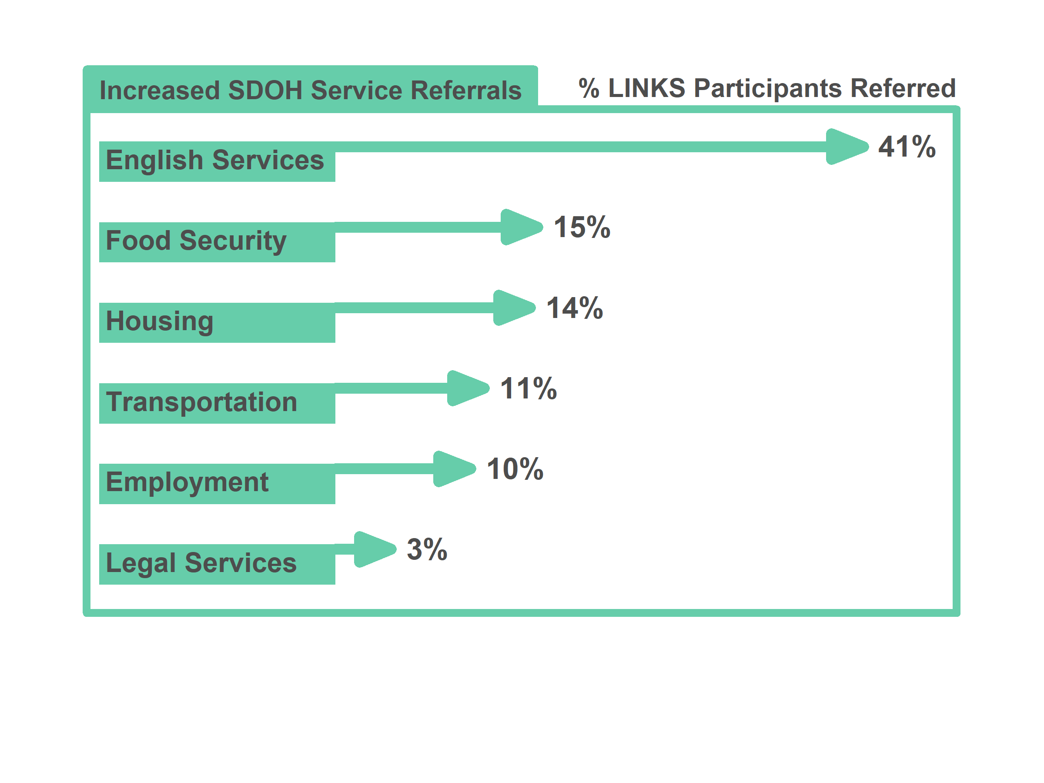
Notes:
Income level
Educational opportunities
Occupation, employment status, and workplace safety
Gender inequity
Racial segregation
Food insecurity and inaccessibility of nutritious food choices
Access to housing and utility services
Early childhood experiences and development
Social support and community inclusivity
Crime rates and exposure to violent behavior
Availability of transportation
Neighborhood conditions and physical environment
Access to safe drinking water, clean air, and toxin-free environments
Recreational and leisure opportunities

Slide 12
Support provided by CHWs
Emotional
Listen to the challenges the participant is experiencing in a non-judgemental fashion.
Appraisal
Assist participants in a process of specific problem they want to work on and identify next steps.
Informational
Identify resources related to a participants goals and provide resources on how to access them.
Tangible
Provide concrete assistance to a participant to ensure they access a resource

Slide 13
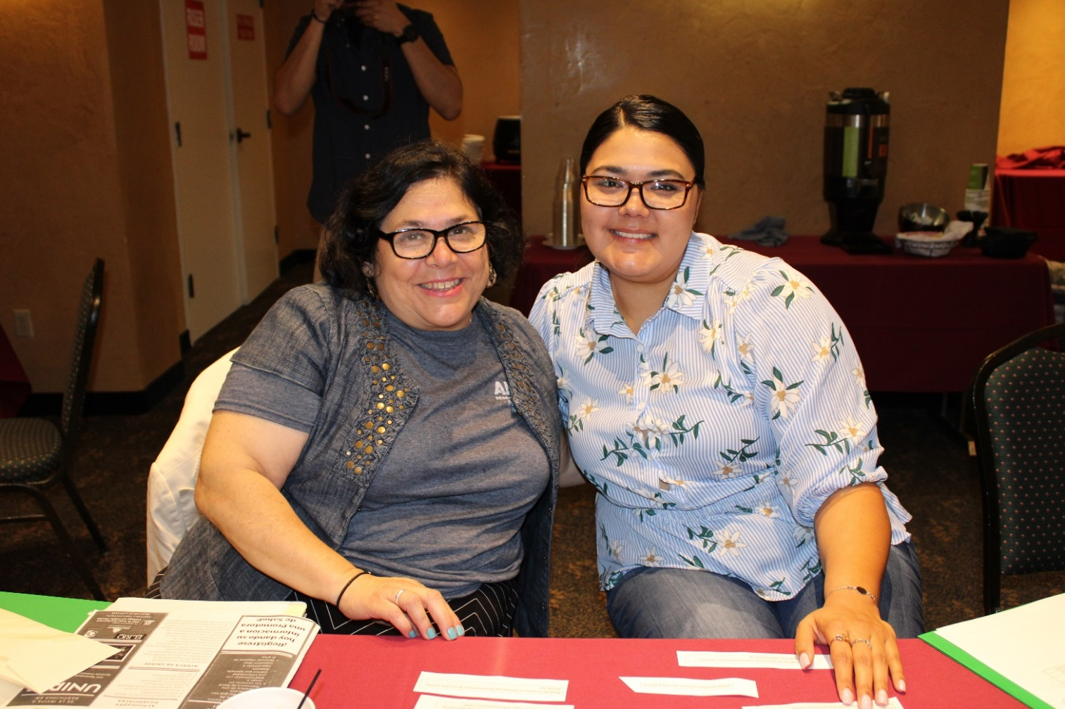
Social Support Inventory
Notes:
MARIA

Slide 14
What is the Social Support Index (SSI)?
7 item scale measuring self-report of structural, instrumental, and emotional support.
Q1-Q6: Responses scored as [1 – 5] (1 = None of the time, …, 5 = All the time)
Q7: Response scored as (2 = No, 4 = Yes)
Scores range from 8 – 34 (larger scores → greater perceived social support)
Please listen to the following questions and select the response that most closely describes your current situation.
Is there someone available to you whom you can count on to listen to you when you need to talk? | Can you count on anyone to provide you with emotional support (talking over problems or helping you make a difficult decision)? Do you have as much contact as you would like with someone you feel close to, someone in whom you can trust and confide? Are you currently married or living with a partner?
Is there someone available to give you good advice about a problem? Is there someone available to you who shows you love and affection? Is there someone available to help you with daily chores?
Notes:
The first element of the Emotional Wellbeing Questionnaire was the Social Support index.
It uses 7 questions, most on a scale of 1 = none of the time to 5 = all o the time. One question is yes/no
Final score range from 8- 35, with higher score indicating greater perceived social support, larger scores always indicate better outcomes in this presentation
Questions: look at your packet!
We are going to look at these in 3 different ways and include our interpretation
one gives you an overall view of how all participants did, another breaks the participants down by their initial score, and a third zooms in on 2 questions.

Slide 15
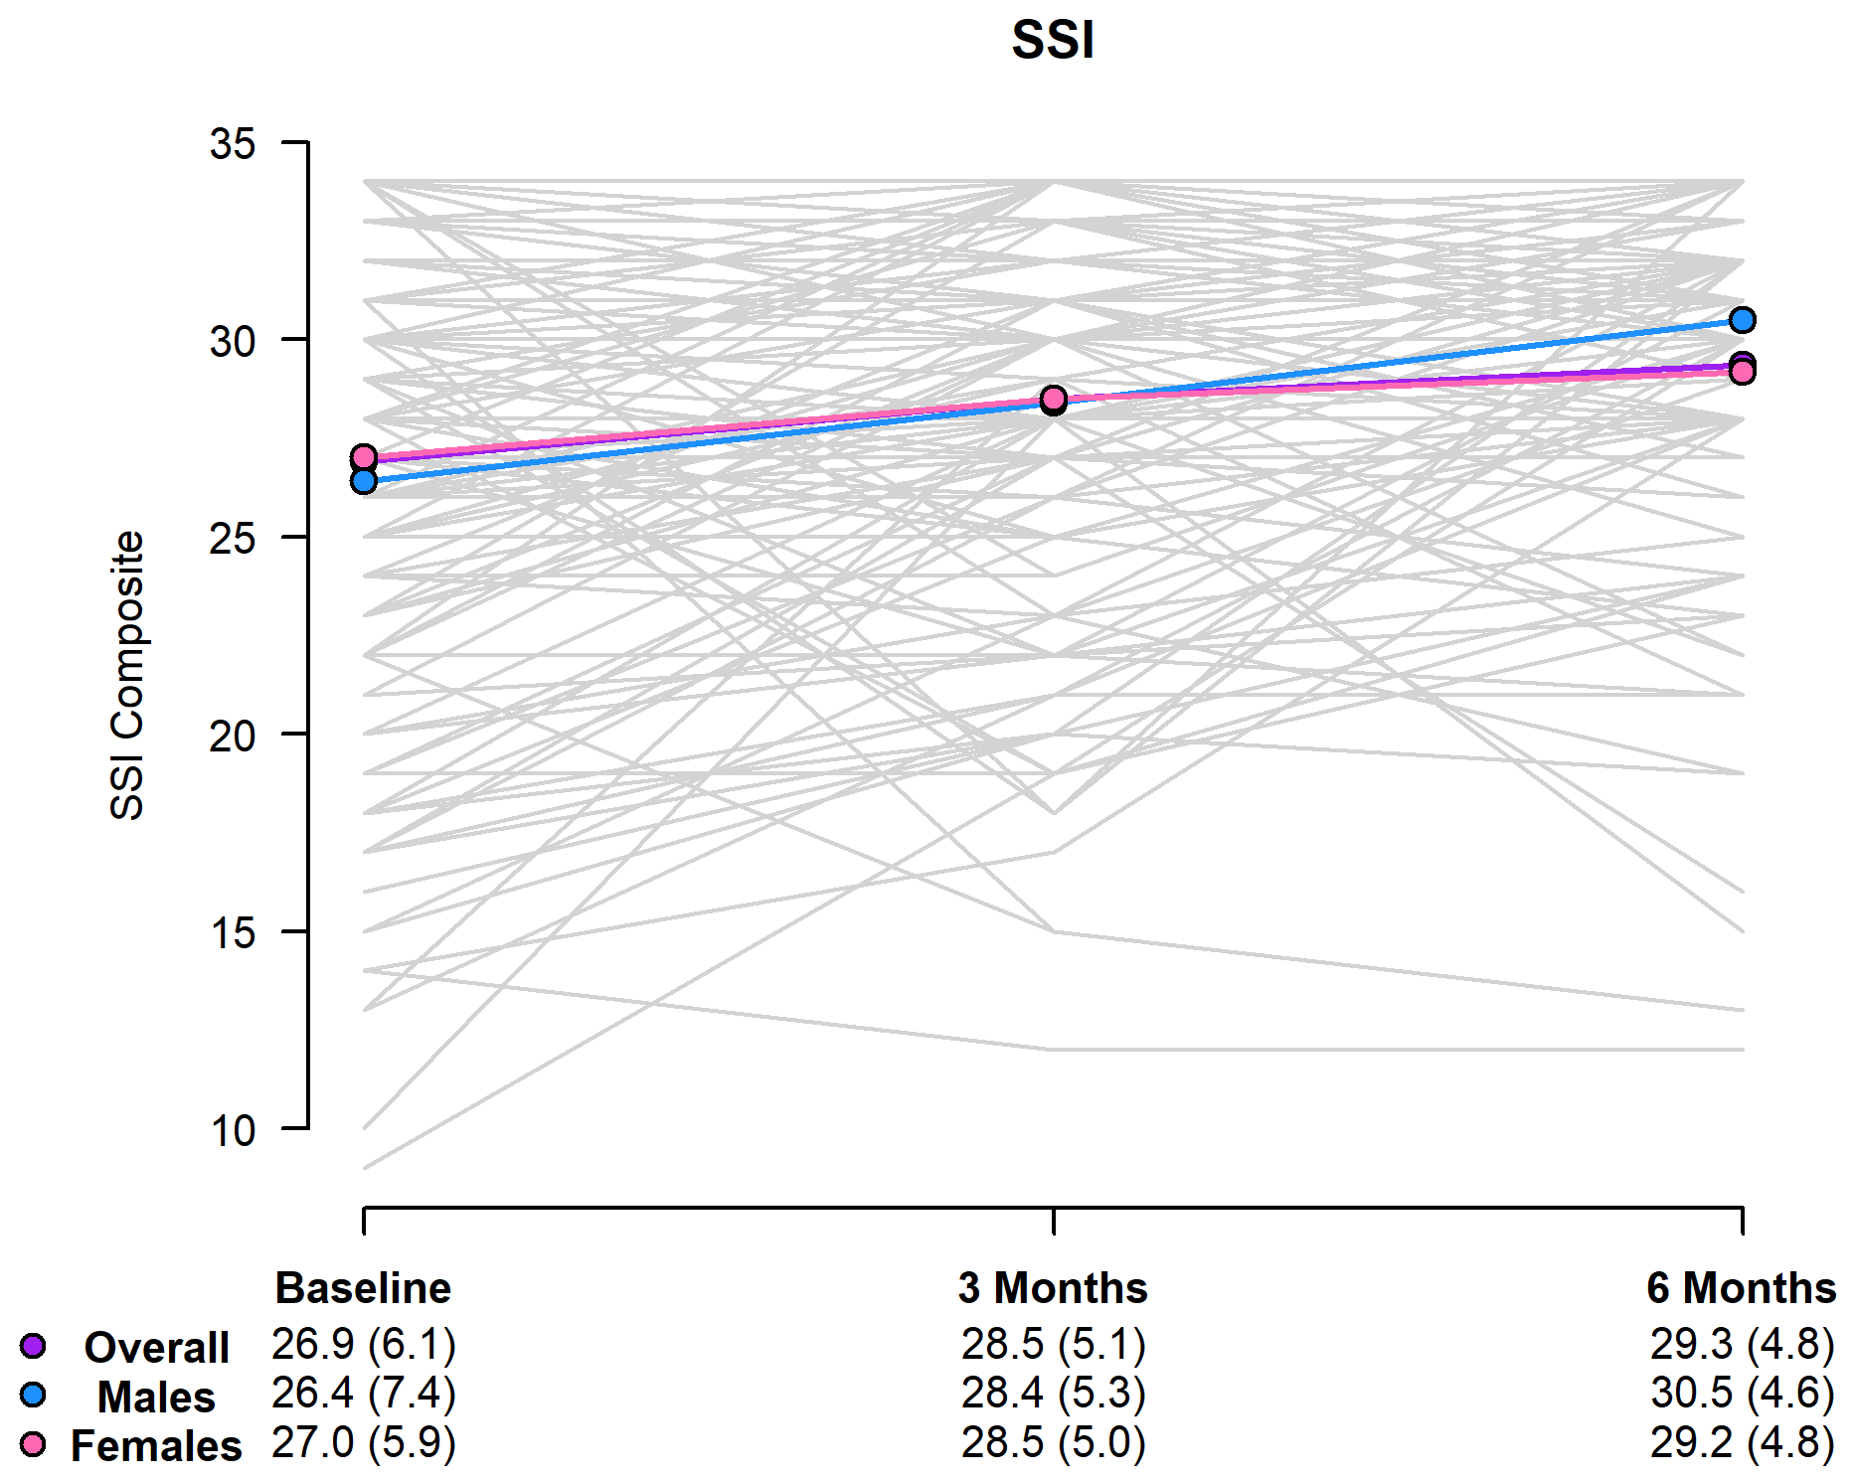
Social Support Inventory (SSI) – Participant Trajectories
Mean increase of 2.57 units from baseline to 6 months follow up
57% of participants had observed increase in SSI score from baseline to 6 months follow up.
Notes:
- The increase of 2.57 units was statistically significant
The “female” and “overall” trends are basically the same since most of the 189 participants were female
Summaries shown at the bottom of the plot are given as mean (standard deviation).
each grey line represents one participant’s trajectory over the 3 times they completed the survey
This is good news! The results are statistically significant, with a mean increase of 2.57.
Like any survey, the results could be subject to different effects and biases.
One strength of the program is that it includes not only participant self-report, but also document’s the CHW’s perception of how the patient is doing bases on their observations and discussion. The CHWs all said that many participants would self-report that they were OK, then reveal pretty serious challenges and problems in their lives, especially in the initial visits. So it’s possible that the effect shown here isn’t the full effect, because people weren’t aware of or didn’t want to reveal their problems in initial surveys.

Slide 16
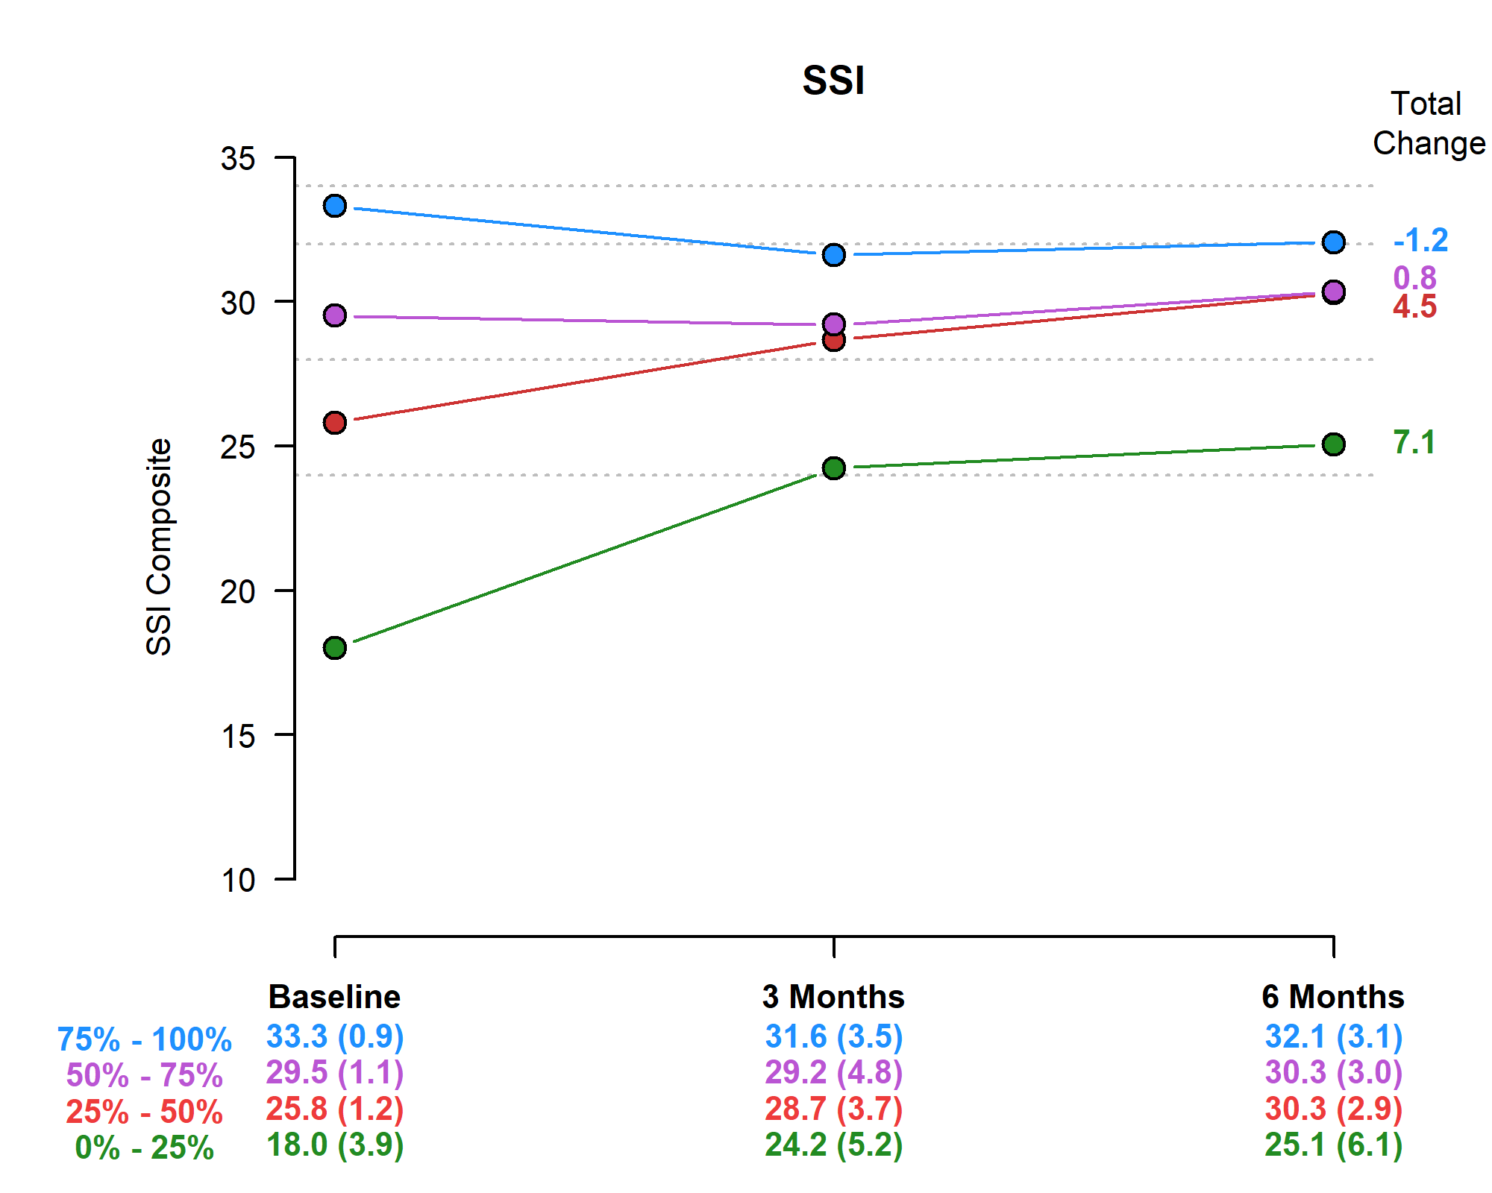
Change in SSI by Baseline Quartile
Divide participants into 4 groups based on baseline SSI scores
Change in SSI from baseline to 6-months follow up was greatest for those with lowest initial SSI scores
Notes:
Summaries at the bottom of figure are given by quartile.
The group 75% - 100% are the top 25% of participants based on SSI baseline score (baseline mean = 33.3)
The group 50% - 75% had the second highest baseline SSI scores (baseline mean = 29.5)
The group 25% - 50% had the third highest baseline SSI scores (baseline mean = 25.8)
The group 0% - 25% had the lowest baseline SSI scores (baseline mean = 18.0)
Another way of looking at the results is by breaking participants into 4 groups based on their baseline score.
This helps us see the “ceiling effect” which means that participants that started out with extremely high scores didn’t have as much room for improvement. Participants that had lower initial scores saw much larger increases, showing a bigger impact of the program.

Slide 17
Focus Group Demographics
Four CHW-led six focus groups (n= 52) (two per site) with LINKS participants.
Focus group participants were primarily Latinas ages 33 to 83 years.
Participants were asked questions about their health, challenges to being healthy, resources acquired to promote emotional well-being, and recommendations for improving LINKS.
Notes:
The study CAB research committee participated in the data analysis process where each node that emerged were read and grouped into subthemes by smaller groups of CAB research committee members. Then the group moved on to a second node. There were small group discussions and then each node was discussed as a larger group to make sure the entire CAB research committee was in agreement with the main themes and the sub-themes that emerged.

Slide 18
Results: Four Main Themes
Barriers to Maintaining Health
Prevention Strategies
CHW Effect or Impact
Recommendations
Notes:
Send node document of all the recommendations

Slide 19
Barriers to Maintaining Health
“I have a lot of resources but my mind tells me to use them but my body says no”
“Yo tengo muchos recursos pero mi mente dice úsalos pero mi cuerpo dice que no.”
Notes:
This theme included:
Lo cultural: upbringing, mindset, the custom of eating together; perspective on the role of food; self-motivation (falta de) (not able to take care of yourself because of taking care of others); self-blame = cultural blame
Duality of state of mind: negativity vs. positivity = stress; mentality of how they perceive things could be positive or negative
Mi reto: owning the barriers
Gender perspective: role of women (recognizing the choice they make in deciding to take care of others); taking care of grandkids
Lack of motivation: lack of self-control; inability to take recommendations
Tension between should and want
Equating oneself with bad behavior: “I am gula” or “No tengo tolerancia”
Benefits of sacrificing are too hard: Too far away; “What’s the point”
Sense that you cannot get good medical services

Slide 20
Barriers to Maintaining Health
Gender Roles
Lack of Motivation
Duality of State of Mind
Cultural
Notes:
This theme included:
Lo cultural: upbringing, mindset, the custom of eating together; perspective on the role of food; self-motivation (falta de) (not able to take care of yourself because of taking care of others); self-blame = cultural blame
Duality of state of mind: negativity vs. positivity = stress; mentality of how they perceive things could be positive or negative
Mi reto: owning the barriers
Gender roles/perspective: role of women (recognizing the choice they make in deciding to take care of others); taking care of grandkids
Lack of motivation: lack of self-control; inability to take recommendations
Tension between should and want
Equating oneself with bad behavior: “I am gula” or “No tengo tolerancia”
Benefits of sacrificing are too hard: Too far away; “What’s the point”
Sense that you cannot get good medical services

Slide 21
Prevention Strategies
“In the diabetes class, I drank a lot of soda…and one of the first classes that I took was one of the ones that helped me a lot because they would show us how much sugar was in one bottle, that image is engrained in my mind and when I want a soda I think about it and I buy a small soda, that was one of the tools that has helped me in this aspect and emotionally because I know it will cause me harm and I stopped drinking it so I can be better and be more positive”
Notes:
“En la clase de diabetes yo tombama mucha soda, Bueno para ser diabetica era mucha y en una de las primeras clases que tome fue una de las que yo senti que me ayudo mucho porque nomas cuando nos ensenaba el bote de las sodas y veia el azucar no se me quita de mi mente y cuando quiero agarrar una soad pienso y me compro una chiquitito y entonces fue una herramienta que me presentaron que me esta ayudanado en que aspecto emocional por que se que me hace dano y dejar de tomarla para yo estar major que es ser mas positiva.”
Subthemes to emerge:
Physical Activity: exercise, dancing, walking, going to gym, cycling, yoga etc.
Relaxation Techniques: breathing techniques, mindfulness practice, positive thinking, tai Chi,
Distraction: reading, casino, crafts, listening to music, reading books
Healthcare resources: attending doctor’s visits; follow up with doctor’s indications; take medications as prescribed; medication delivery; access to clinic, doctors, labs, therapy, and prevention services at an affordable cost
Community services: support groups, nutrition assessments, diabetes classes
Behavior change: Visual aids to promote behavior change (amount of sugar in soda); connection with dietary change and types of food leading to healthy eating; Modifying cooking habits; checking blood sugar; following a better selection of eating and drinking options (stages of change).
Incentives/setting goals: going on a trip as a reward for losing weight; losing weight in order to complete an activity or task like climbing a mountain.
Fuerza de voluntad: will power, self motivation, techniques are shared and expressed with the desired change outcome.

Slide 22
Prevention Strategies Continuum
Recognizing the need but not a specific strategy
Recognizing the need and identifying specific strategies to create a change to health outcome
Recognizing need, identifying how multiple resources/techniques and putting into action to maintain well-being
Notes:
Subthemes to emerge:
Physical Activity: exercise, dancing, walking, going to gym, cycling, yoga etc.
Relaxation Techniques: breathing techniques, mindfulness practice, positive thinking, tai Chi,
Distraction: reading, casino, crafts, listening to music, reading books
Healthcare resources: attending doctor’s visits; follow up with doctor’s indications; take medications as prescribed; medication delivery; access to clinic, doctors, labs, therapy, and prevention services at an affordable cost
Community services: support groups, nutrition assessments, diabetes classes
Behavior change: Visual aids to promote behavior change (amount of sugar in soda); connection with dietary change and types of food leading to healthy eating; Modifying cooking habits; checking blood sugar; following a better selection of eating and drinking options (stages of change).
Incentives/setting goals: going on a trip as a reward for losing weight; losing weight in order to complete an activity or task like climbing a mountain.
Fuerza de voluntad: will power, self motivation, techniques are shared and expressed with the desired change outcome.

Slide 23
CHW Effect or Impact
Notes:
Subthemes to emerge:
Gratefulness/gratitude/appreciation
Motivational: phone calls
Trust: “Nos sentimos con mucha confianza con usted”; trusting relationship; inspires hope and caring in the individual this allows for trust and bond with the CHW
Informational
Controlling stress: creates a calm environment; relaxation techniques
Resources: prevention/treatment; education about existing resources and how to access them; link to resources/bridge; facilitates access to resources; presence of the CHW is the resource
El poder de hablar: someone that listened to them; participants have a lot to say; participants talked with the CHW and came up with solutions;
Change agent: change perspective; providing hope and light at the end of the tunnel.
Empowering: different from motivation, empowerment more about concrete skills and knowledge
Sense of comfort: caring; CHWs take the time; relief of having someone to talk to/emotional support; supporter; problem solver; ongoing follow up and continuous problem solver; emotional release; life saver; help overcome emotional crisis.

Slide 24
CHW Effect or Impact
“We have a lot of information now that we didn’t have before. And we feel like we have a lot of trust in you”
“Es que tenemos mucha información ahora. Pues que no teníamos. Y luego nos sentimos con mucha confianza con usted”
Notes:
Subthemes to emerge:
Gratefulness/gratitude/appreciation
Motivational: phone calls
Trust: “Nos sentimos con mucha confianza con usted”; trusting relationship; inspires hope and caring in the individual this allows for trust and bond with the CHW
Informational
Controlling stress: creates a calm environment; relaxation techniques
Resources: prevention/treatment; education about existing resources and how to access them; link to resources/bridge; facilitates access to resources; presence of the CHW is the resource
El poder de hablar: someone that listened to them; participants have a lot to say; participants talked with the CHW and came up with solutions;
Change agent: change perspective; providing hope and light at the end of the tunnel.
Empowering: different from motivation, empowerment more about concrete skills and knowledge
Sense of comfort: caring; CHWs take the time; relief of having someone to talk to/emotional support; supporter; problem solver; ongoing follow up and continuous problem solver; emotional release; life saver; help overcome emotional crisis.

Slide 25
Recommendations
Including a variety of group activities to counter social isolation:
self-esteem training, dealing with depression class, nutritional label reading class, culturally relevant cooking demonstrations, physical activities including dancing and group workouts
Including more men to participate in these type of programs
Notes:
Other recommendations were:
Open the study up to more individuals in the community
Extending the program to family members including youth

Slide 26
Creating the Unidos Program
We incorporated the recommendations from our community members and CAB partners to streamline our new Unidos Program.
COVID impact

Slide 27
Our LINKS and Unidos Team
Pima County Health Department
Yuma County Health District
Mariposa Community Health Center
Maricopa County Department of Public Health
Arizona Community Health Outreach Worker Association (AzCHOW)
El Rio Health Center
Sunset Community Health Center
Arizona Prevention Research Center(AzPRC) Community Action Board

Slide 28
Clinical-Community Linkages
Created a referral form and warm-line for Pima County Health Department preventative care services and provided training to local health and non-profit agencies on how to use the form.
REACH CHWs will also be working with REACH priority clinics to enroll patients into PCHD preventative care programs.
Notes:
An effort by four University of Arizona students to provide information about the coronavirus to Tucson’s Spanish-speaking community has gained financial backing from the U.S. Centers for Disease Control and Prevention, along with city and county support.
Printing of the posters was supported by the college’s Commitment to Underserved People program and city council members Richard Fimbres and Lane Santa Cruz. Funding from CDC became available when the students connected with Mary Kinkade, a Pima County Health Department program manager and local director of the CDC’s Racial and Ethnic Approaches to Community Health (REACH) program.

Slide 29
Thank you!
Contact information:
Ada Wilkinson-Lee
adaw@email.Arizona.edu
(520) 626-7766

